Slide 1


BUILD YOUR PERSONAL AI AGENT WITH CLAUDE CODE

Slide 2

10 Automations. All Connected.
01
02
03
04
05
Sprint Tracker
Morning Brief
Market Pulse
Research Team
Personal CRM
Project board
Daily snapshot
Competitor radar
Multi-agent research
Relationship tracker
© All rights reserved for Dr. Ryan Ahmed @Stemplicity Inc.
06
07
08
09
10
Meeting Intel
Email Triage
Expense Wrangler
Content Machine
Weekly Exec Report
Prep & extraction
Inbox manager
Receipt processing
Multi-format content
Capstone rollup
Each automation reads from the vault, does its job, and writes back. The system compounds.

Slide 3
EXPENSE WRANGLER

Slide 4
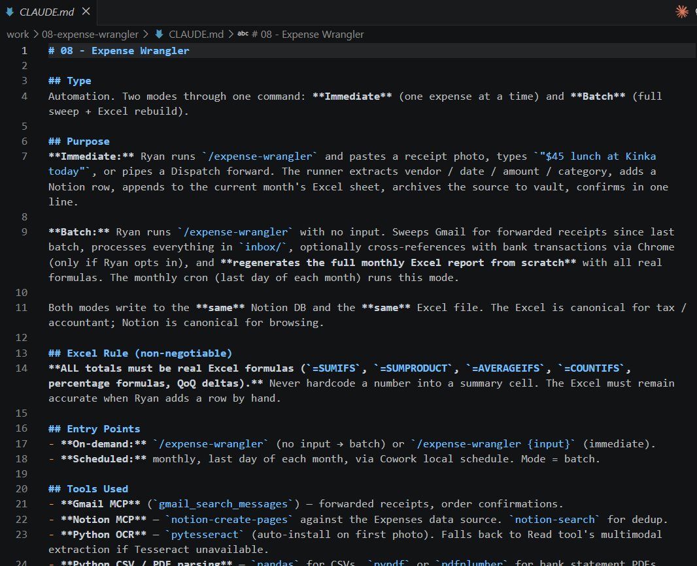
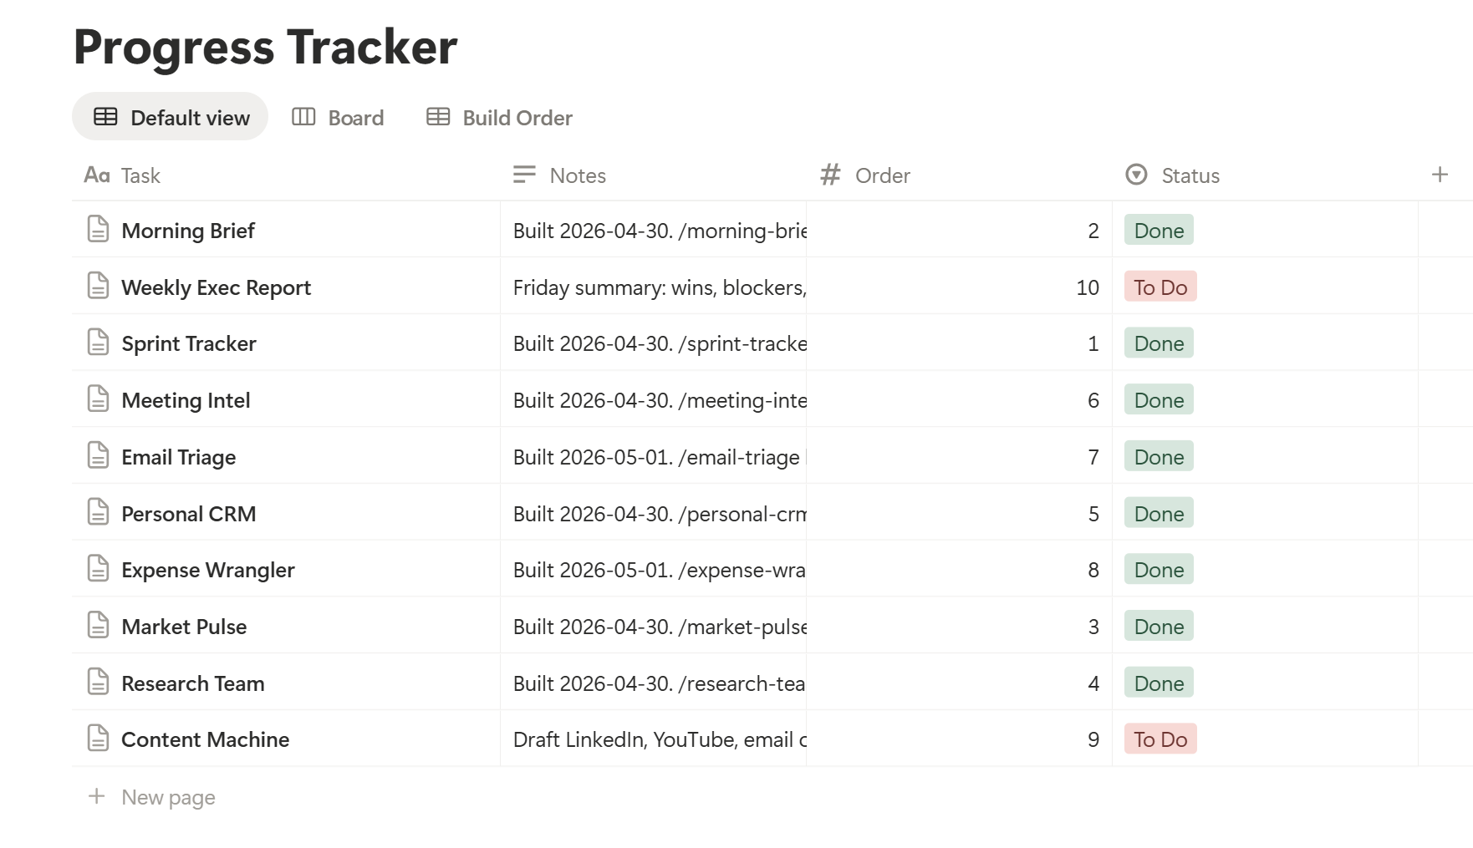
Prompt 8: Expense Wrangler
After running the Expense Wrangler, a Claude.md file is created under the work folder along with a new slash command.
© All rights reserved for Dr. Ryan Ahmed @Stemplicity Inc.

Slide 5
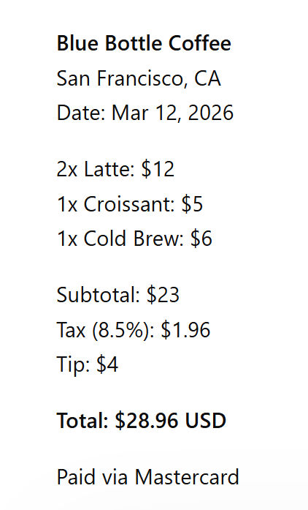
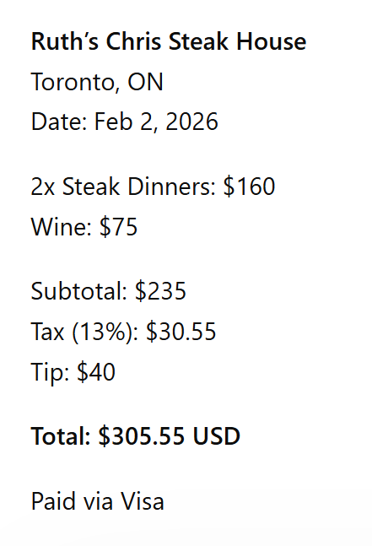
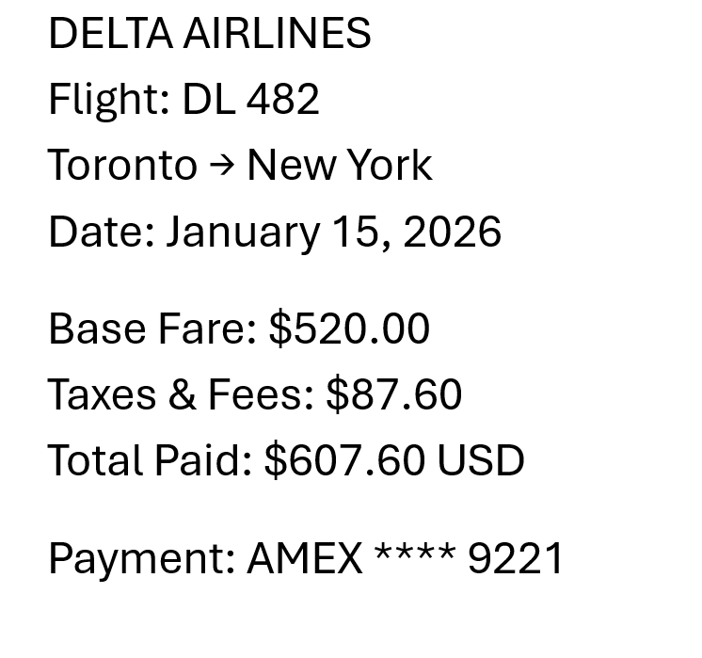
Sample Test Data
© All rights reserved for Dr. Ryan Ahmed @Stemplicity Inc.

Slide 6
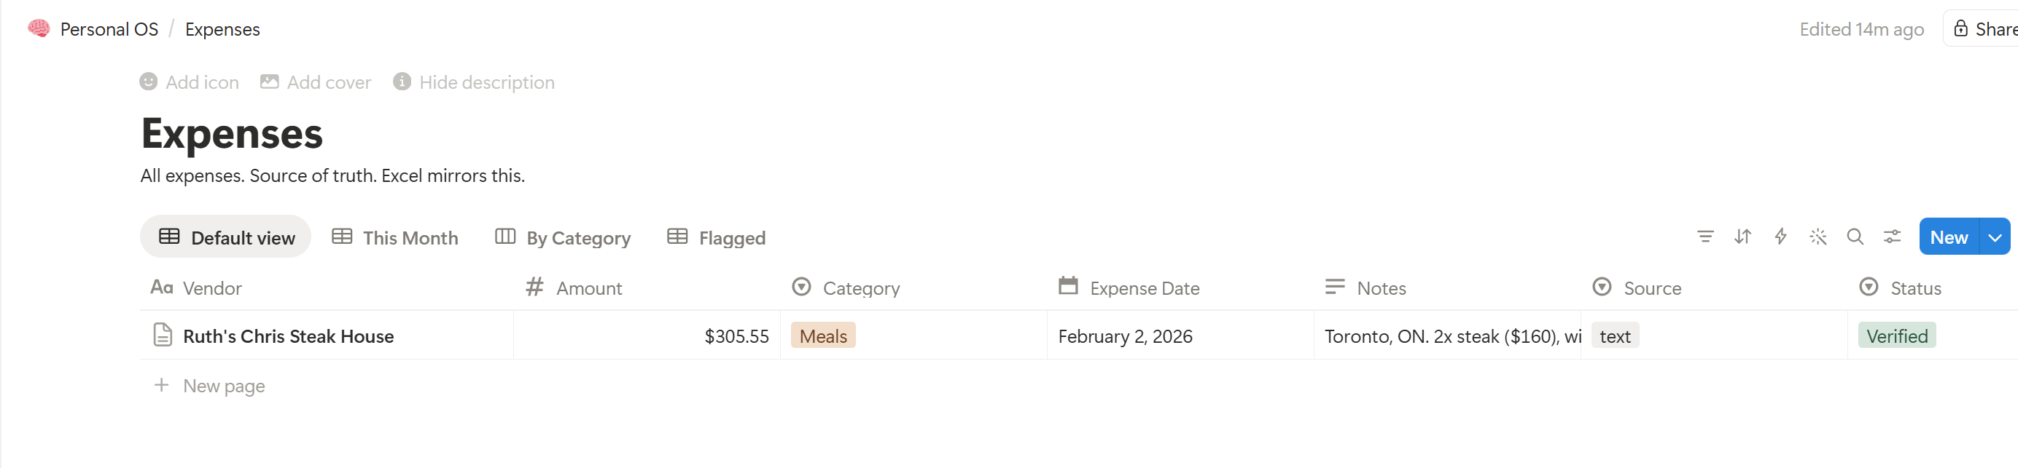
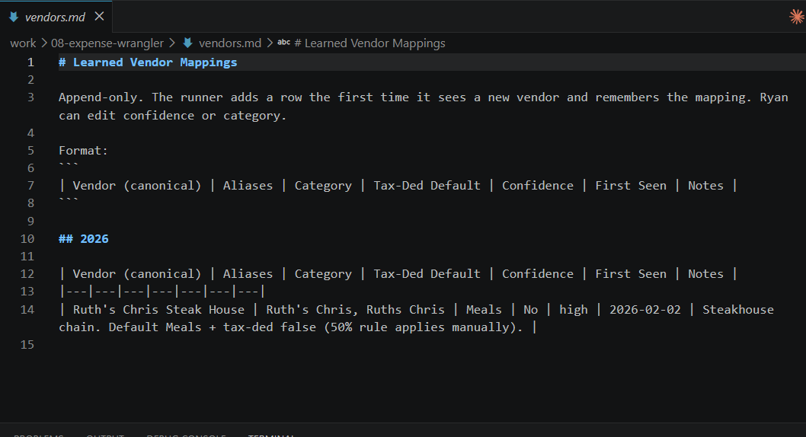
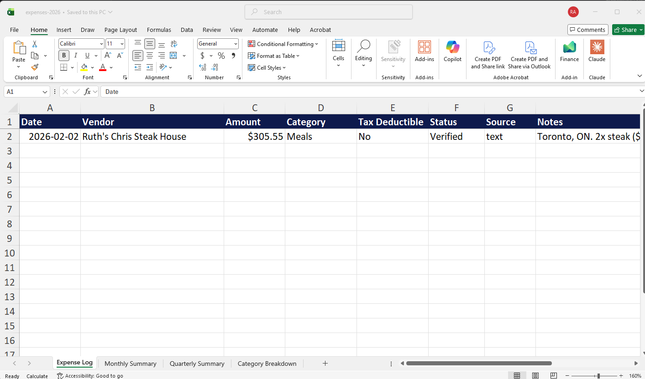
Let’s run the Expense Wrangler
© All rights reserved for Dr. Ryan Ahmed @Stemplicity Inc.

Slide 7
CONTENT MACHINE

Slide 8
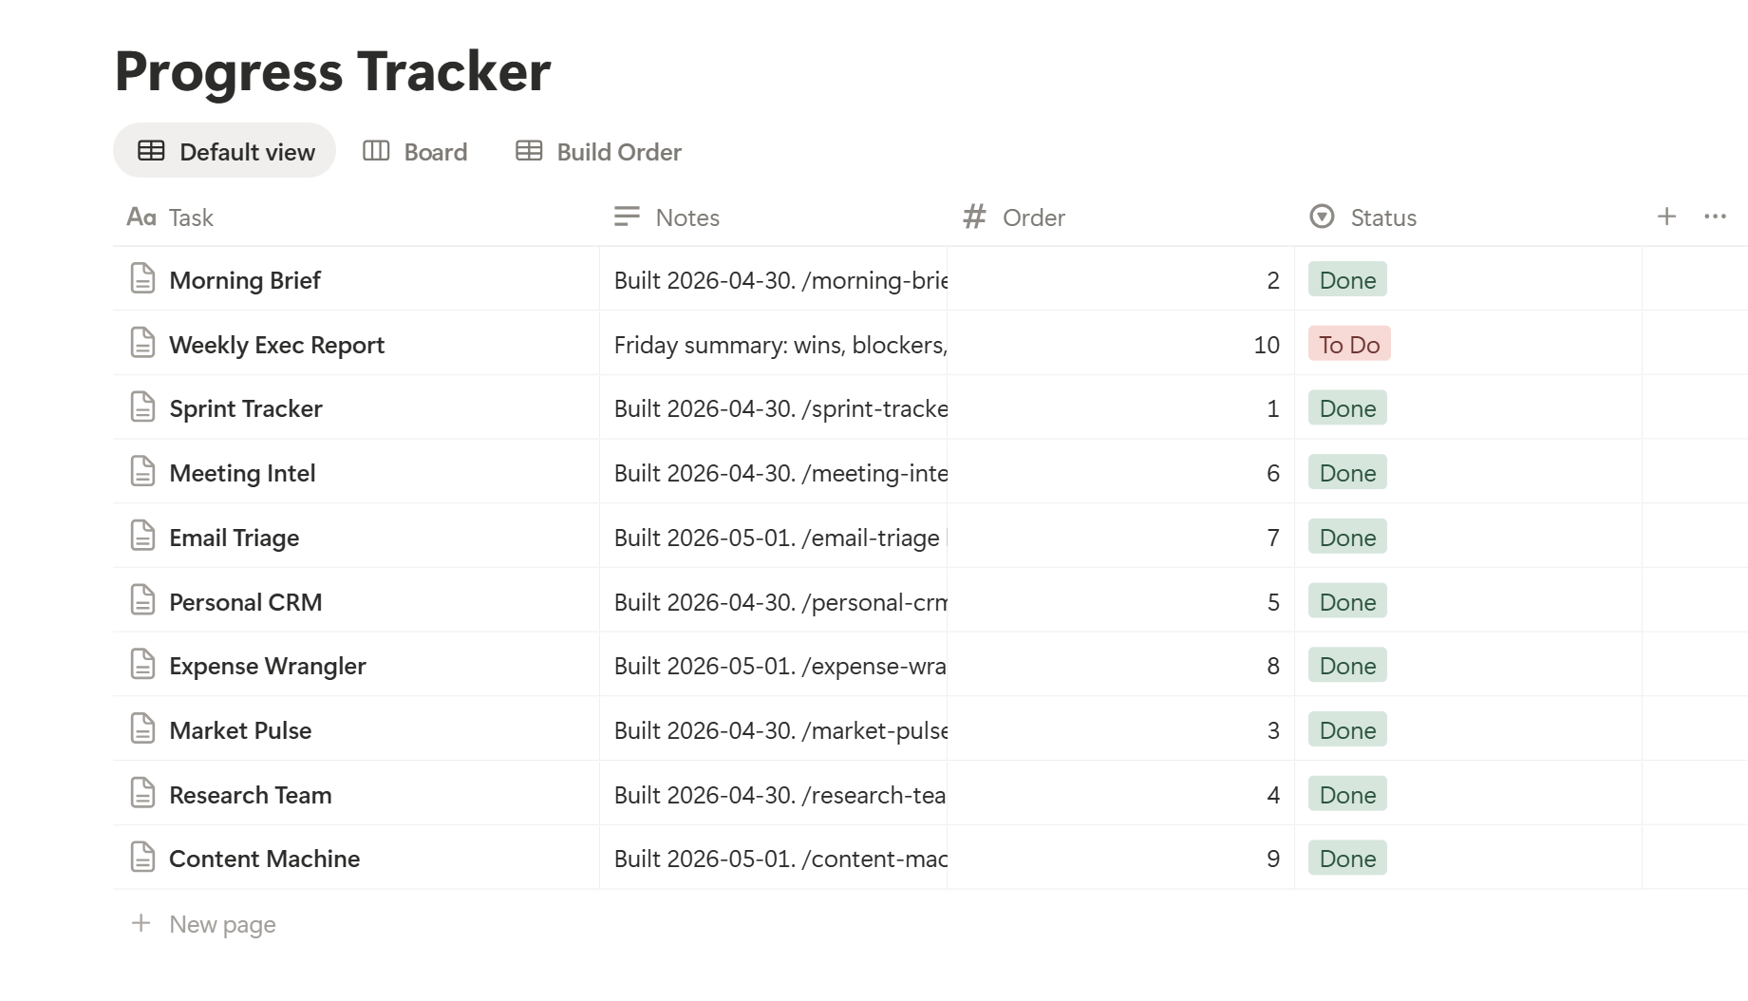
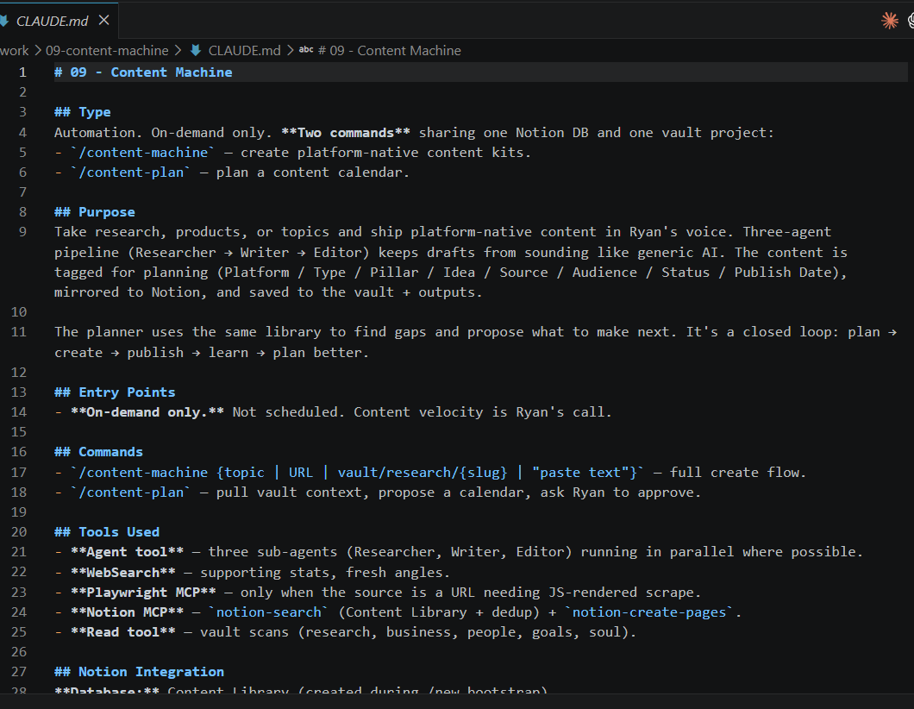
Prompt 9: Content Machine
After running the content machine, a Claude.md file is created under the work folder along with a new slash command.
© All rights reserved for Dr. Ryan Ahmed @Stemplicity Inc.

Slide 9
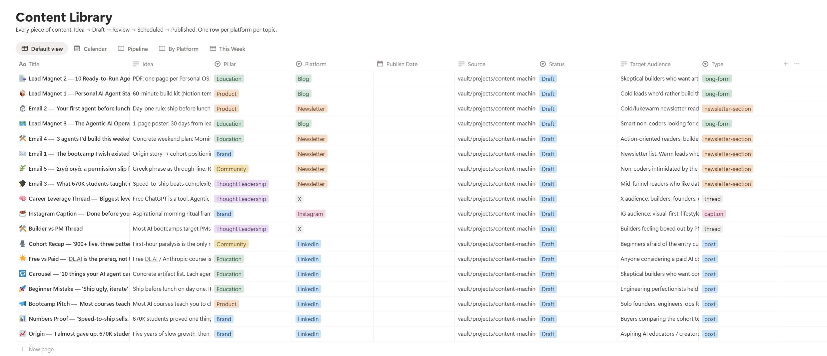
Let’s run the content machine
/content-machine
Turn my new Claude Code and Cowork Cohort on Maven into a content machine → generate 5 high-converting posts, 5 email ideas, and 3 lead magnets with strong hooks and CTAs.
/content-plan
I want to launch a new Claude Code and Cowork Cohort on Maven. Create a content plan for it.
© All rights reserved for Dr. Ryan Ahmed @Stemplicity Inc.

Slide 10
WEEKLY EXECUTIVE REPORTING

Slide 11
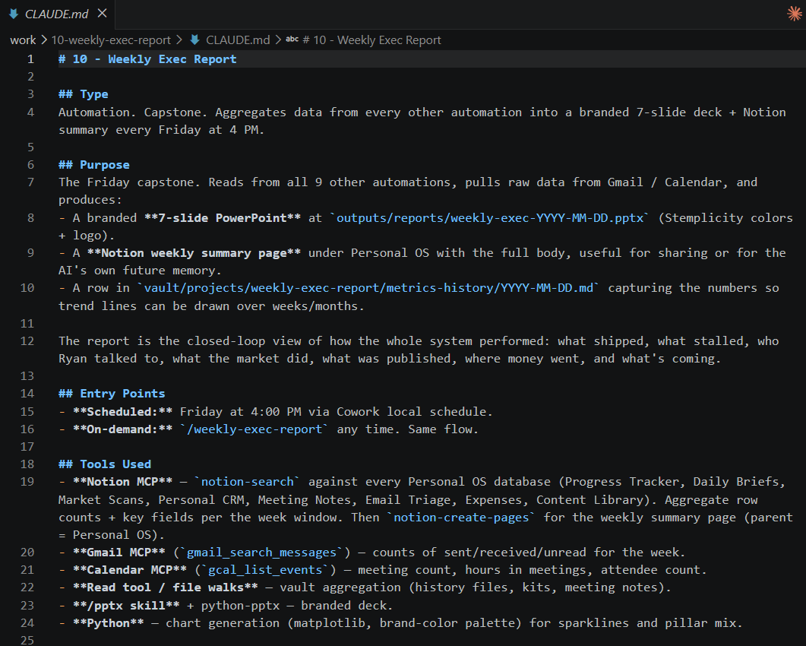
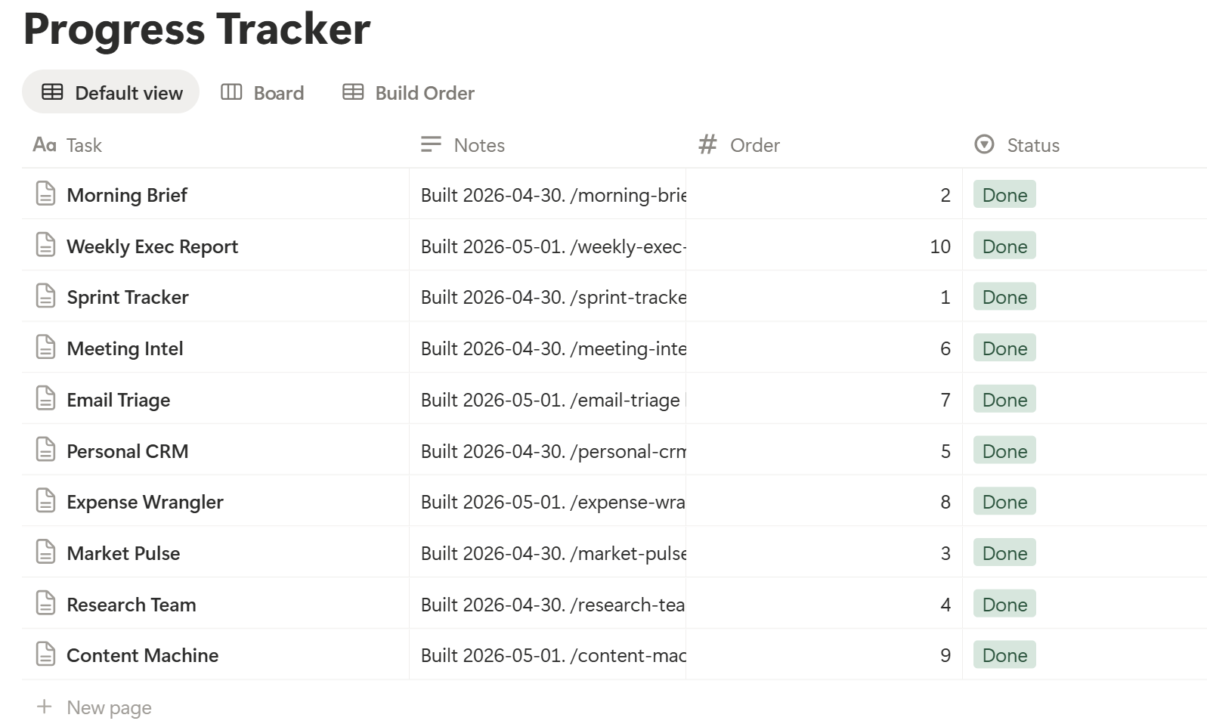
Prompt 10: Weekly Executive Report
After running the weekly executive report, a Claude.md file is created under the work folder along with a new slash command.
© All rights reserved for Dr. Ryan Ahmed @Stemplicity Inc.

Slide 12
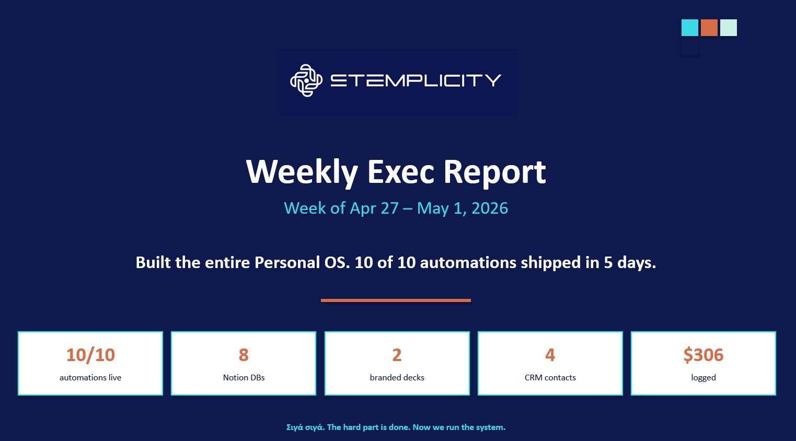
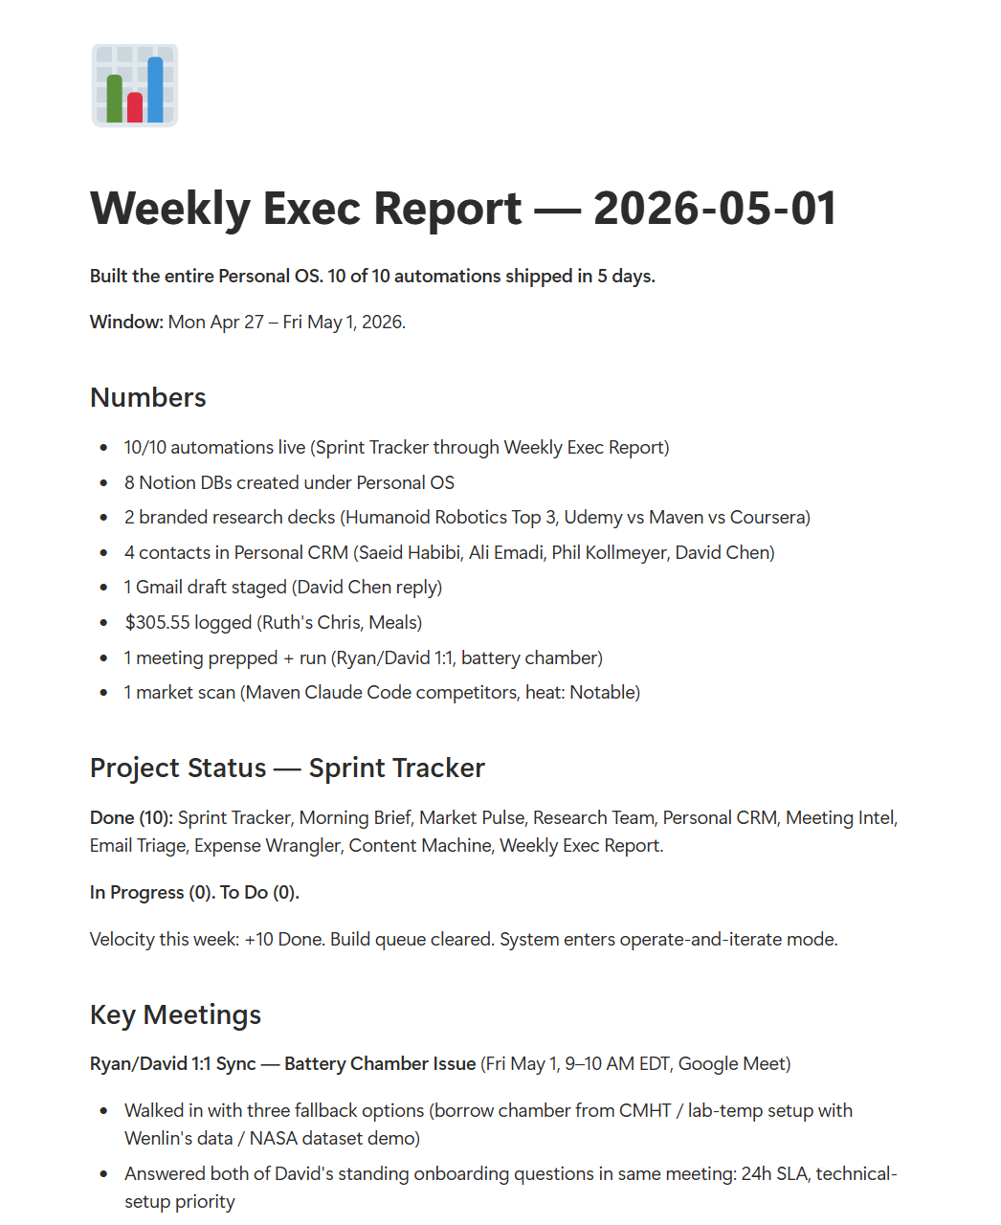
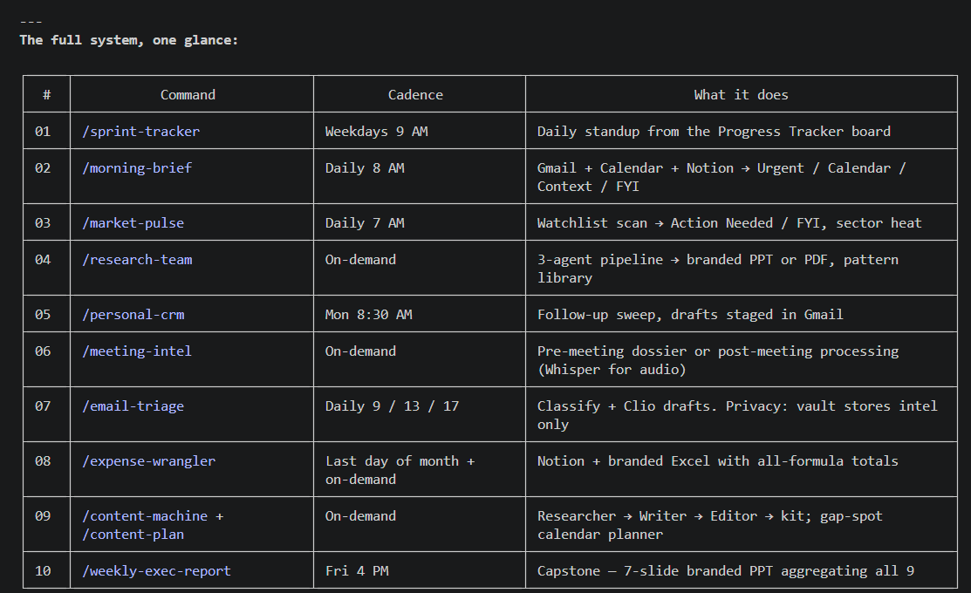
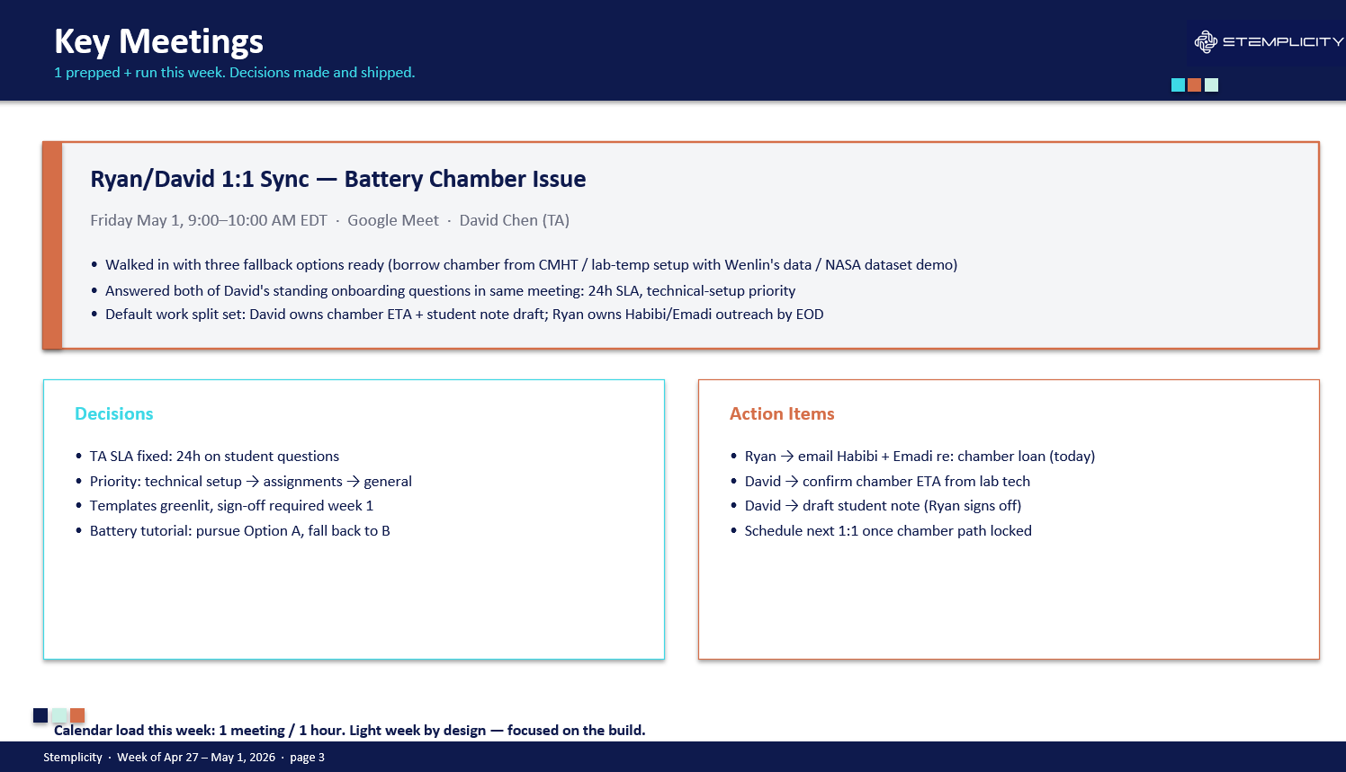
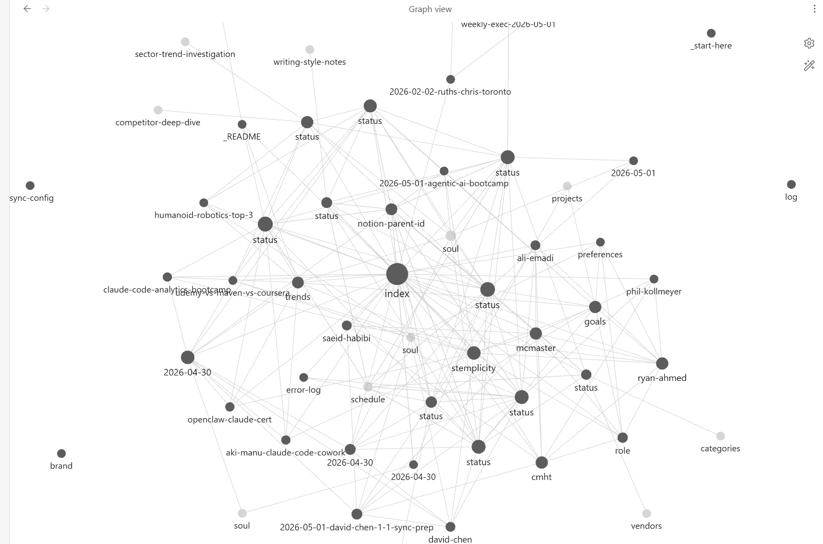
After Running the Weekly Executive Report
After running the weekly executive report, a Claude.md file is created under the work folder along with a new slash command.
© All rights reserved for Dr. Ryan Ahmed @Stemplicity Inc.

Slide 13
Thank you!

Slide 14
If something breaks
COMMON FIXES
Most issues are MCP-related. These cover 90%.
MCP tool not loading
Type ToolSearch in chat. Loads deferred MCP tools. Or restart Claude Code if persistent.
Notion DB write fails
Check vault/projects/error-log.md — known fixes are logged. Date format is date:Field:start, not flat string.
© All rights reserved for Dr. Ryan Ahmed @Stemplicity Inc.
Gmail draft stuck
Use gmail_create_draft MCP, never Chrome. The Chrome MCP cannot send via Gmail.
soul.md sounds generic
Add more writing samples to inbox/, run /ingest. soul.md updates as you feed more voice.
Vault feels stale
Run /lint. Reports orphans, broken links, stale pages, missing cross-references. /lint --fix applies safe ones.

